Slide 1
Water Quality of Black Hawk Creek and an Agricultural Run-Off
GROUP-02
Chris Britt and Aminul Haque

Slide 2
Study Area

Slide 3
Site Description
Agricultural Run-off
Black Hawk Creek

Slide 4
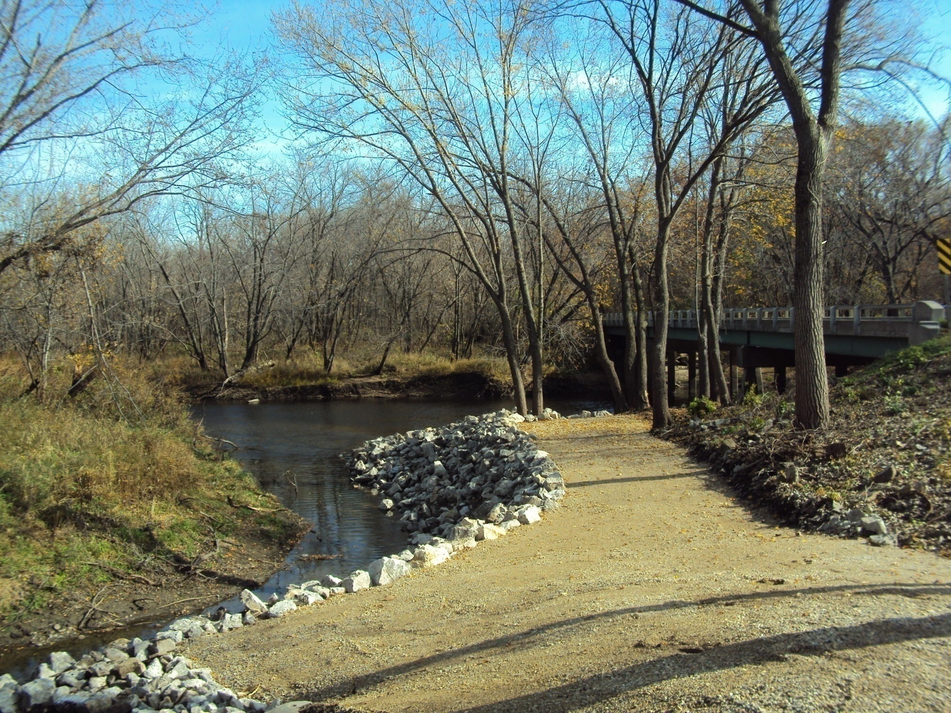
Continued…..

Slide 5
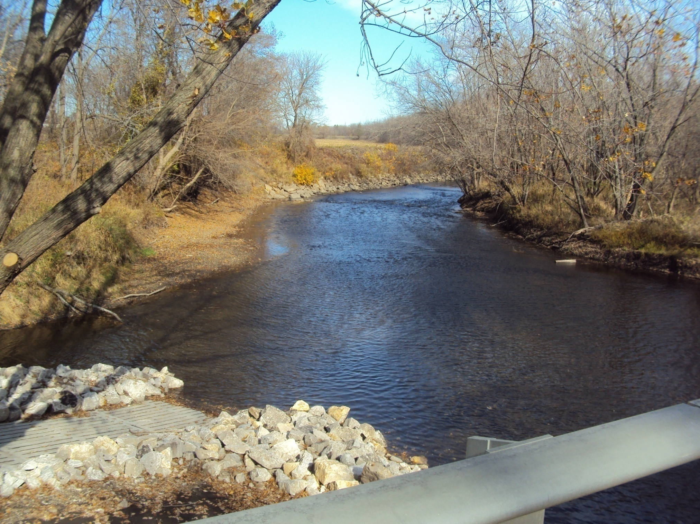
Continued…..
Black Hawk Creek
Agricultural Run-off

Slide 6
Objectives
Conduct Group Project
Water Quality Analysis of Black Hawk Creek
Variation of Water Quality Over Time
Contribution of Agricultural Run-off into Black Hawk Creek
Determination of Water Quality Index (WQI)

Slide 7
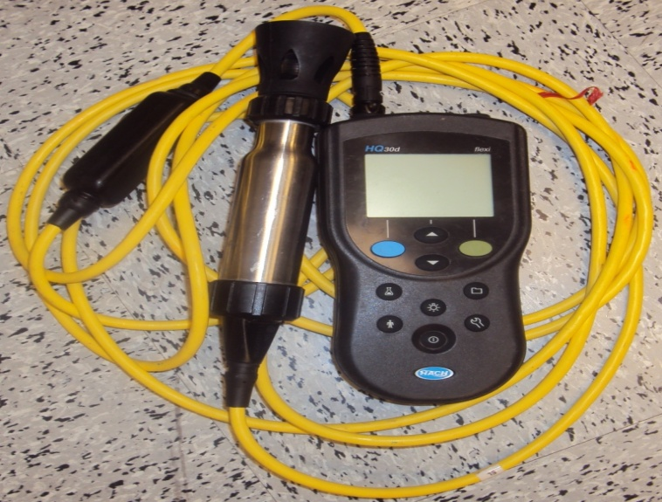
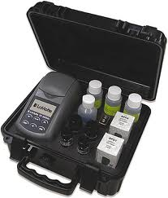
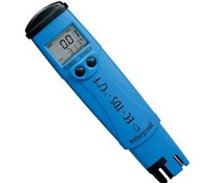
Field Methods
Instrument Used in Field

Slide 8
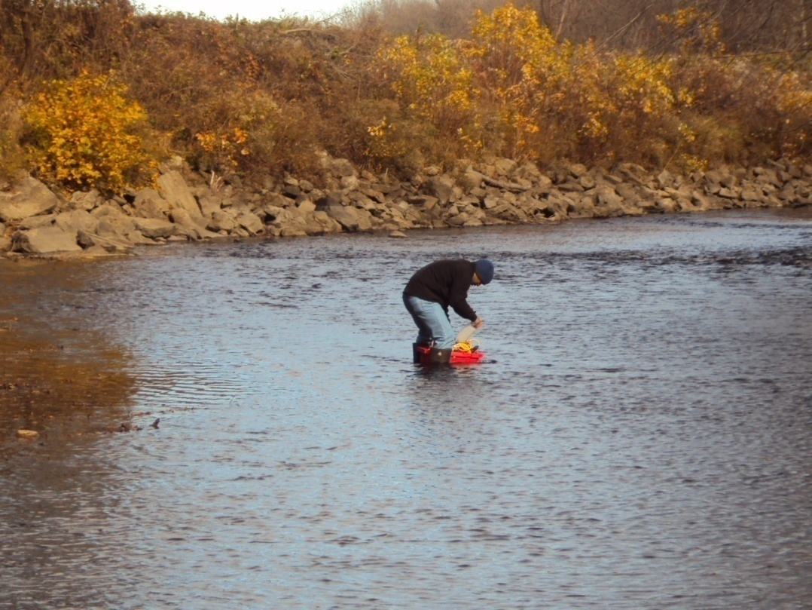
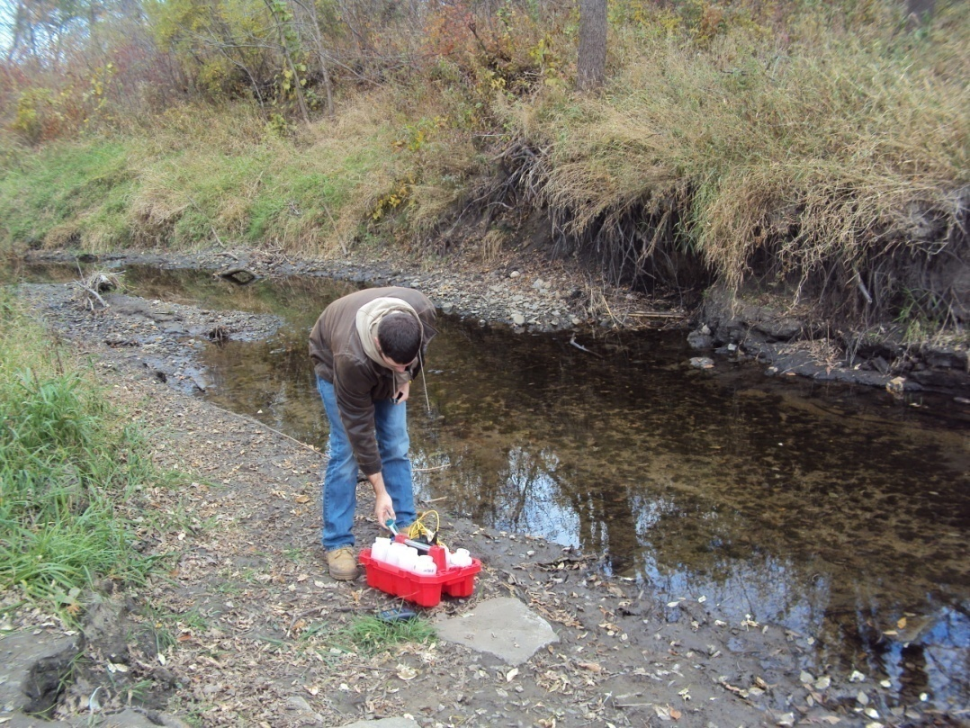
Field Methods
On Site Measurement

Slide 9
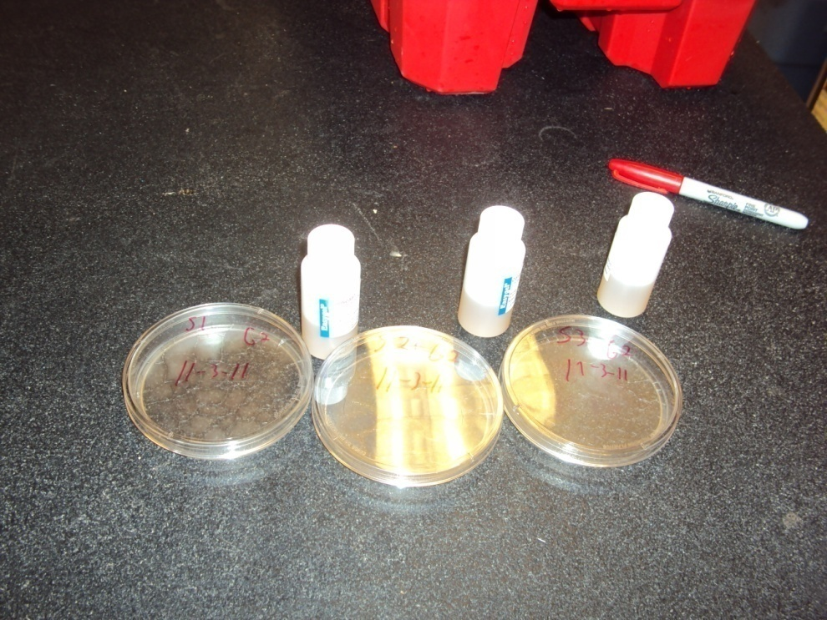
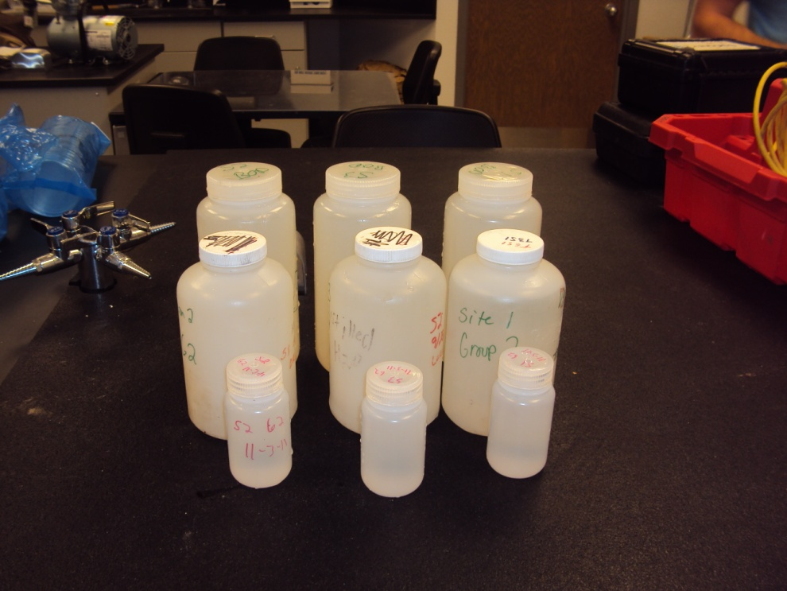
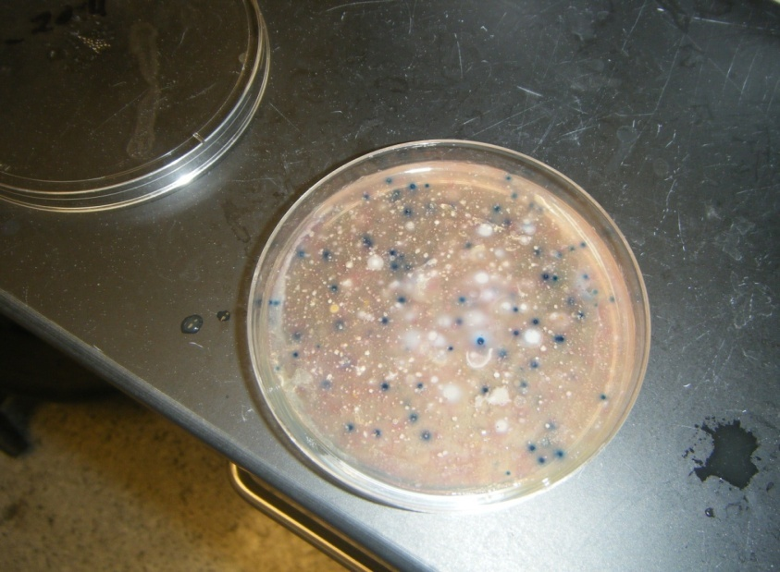
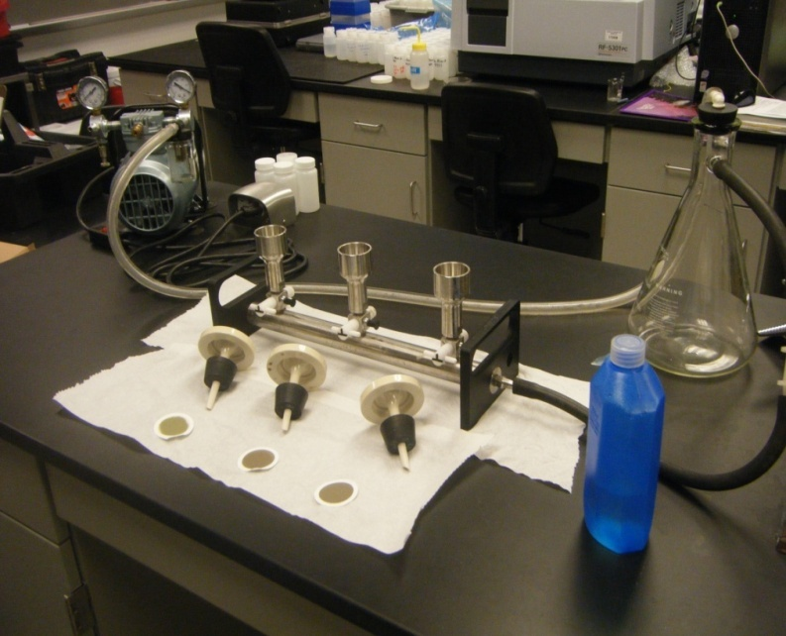
Lab Methods

Slide 10
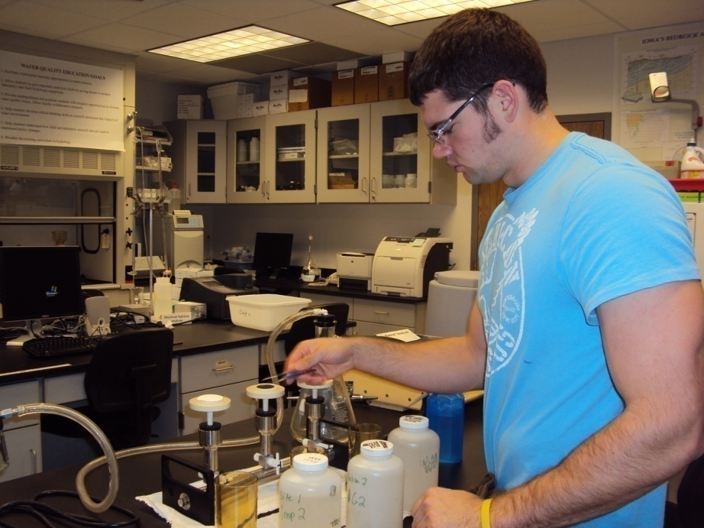
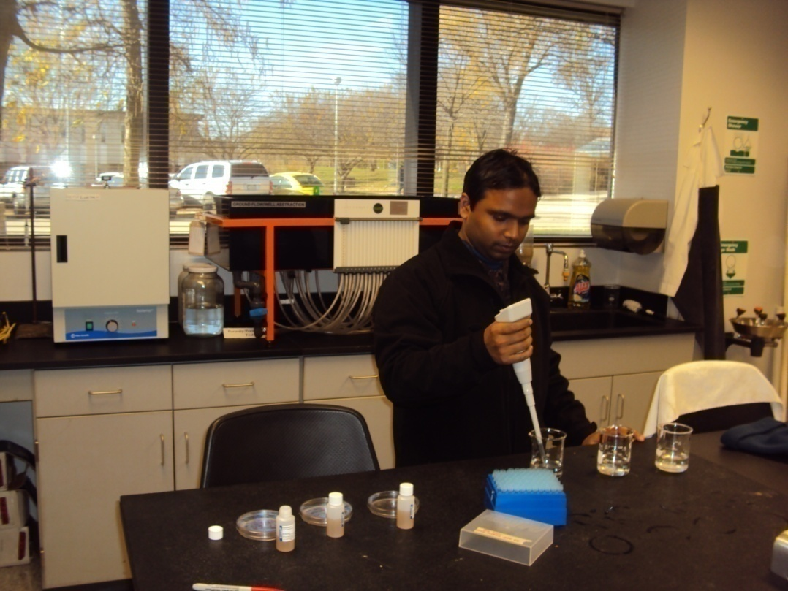
Lab Methods

Slide 11
Water Quality

Slide 12
Water Quality

Slide 13
Water Quality

Slide 14
Water Quality

Slide 15
Water Quality Index
Excellent
Good

Slide 16
Contribution of Ag. Run-off
BOD concentration increases after rain.
High E-coli concentration
High TDS
Chloride and Sulfate

Slide 17
Conclusion
Dissolved Oxygen Concentration is good for Aquatic life.
BOD increases after rain.
TSS varies over time.
High E-coli concentration due to rain and construction work.
Agricultural run-off contributes chloride and Sulfate.
Overall WQI is Good.

Slide 18



